Slide 1
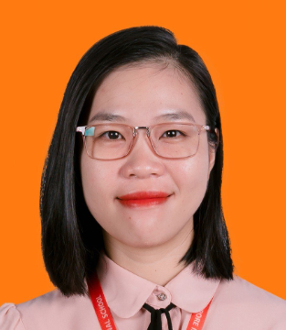
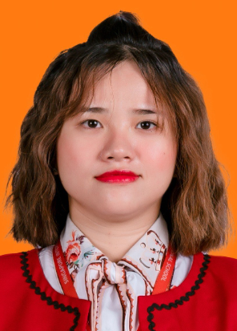






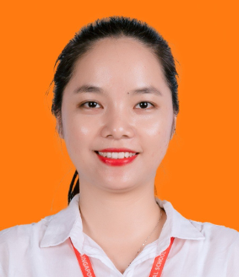

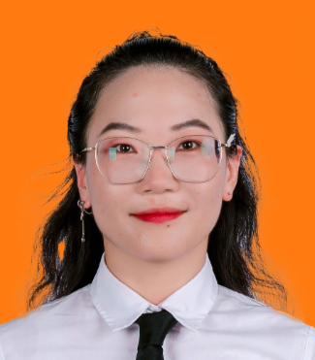
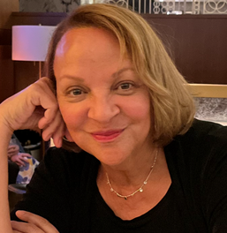
Integrated
Nursery
Teacher | Ms. LE HONG HANH
Teacher | Ms. LUU THI HONG DIEM
Integrated
K1
Teacher | Ms. PHAM THI KIM NGAN
Teacher | Ms. LE THI MY TU
Kindergarten
Teachers
Integrated
K2
Teacher | Ms. NGUYEN CAM TIEN
Teacher | Ms. DANG THI HUYEN TRANG
Integrated
Prep
Teacher | Ms. NGUYEN THI LINH
Teacher | Mr. LUDWIG SANTOS MINDO DE VARONA
Teacher | Ms. LUONG THI SUONG
Specialist
Teachers
Teacher | Mr. LUDWIG SANTOS MINDO DE VARONA
Subject Class | Music KIK
Teacher | Mr. JULIUS LABANAUSKIS
Subject Class | PE KIK
Teacher | Ms. GUO TING
Subject Class | Chinese KIK
Teacher | Ms. LAGRETA CARROL
Subject Class | EFL KIK

Slide 2








Year 1
Integrated
Teacher | Ms. PHAN THI OANH
Teacher | Ms. LIEZL EKSTEEN
Year 2
Integrated
Teacher | Ms. NGUYEN THI NGOC QUY
Teacher | Ms. LIEZL EKSTEEN
Primary Class
Teachers
Year 3
Integrated
Teacher | Mr. NGO CHI THANH
Teacher | Ms. JAMIE-LEIGH CLOKE
Year 4
Integrated
Teacher | Mr. VO NGOC BA PHUOC
Teacher | Ms. JAMIE-LEIGH CLOKE
Year 5
Integrated
Teacher | Ms. LE DUONG BAO NGOC
Teacher | Mr. VEREN TOOLSIRAM

Slide 3

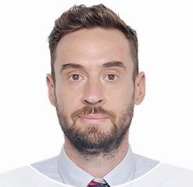

Music
Teacher | Mr. LUDWIG SANTOS MINDO DE VARONA
Class | All primary classes
PE
Teacher | Mr. JULIUS LABANAUSKIS
Class | All primary classes
Primary
Specialist
Teachers
Science
History
Geography
Teacher | Ms. NGUYEN THI THUY QUYNH
Class | Y4 and Y5
ICT
Teacher | Mr. STEVEN THOMAS GIBSON
Class | All primary classes
Chinese
Teacher | Ms. GUO TING
Class | All primary classes
EFL
Teacher | Mr. PETER MICHAEL MC CLEMONT
Class | All primary classes

Slide 4


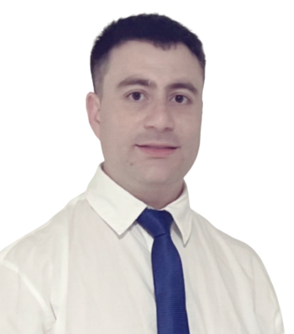



Year 6
Integrated
Teacher | Ms NGUYEN THI NIEM
Subject | Biology
Teacher | Mr. PETER MICHAEL MC CLEMONT
Subject | English & Global Perspectives
Secondary
Class
Teachers
Year 7
Integrated
Teacher | Ms. NGUYEN NGOC PHUONG THAO
Subject | Physics
Teacher | Mr. OSVALDO ANDRE ALISTE PAVEZ
Subject | English & Global Perspectives
Year 8
Integrated
Teacher | Ms. BUI NGOC ANH THU
Subject | Literature
Teacher | Mr. OSVALDO ANDRE ALISTE PAVEZ
Subject | English & Global Perspectives
Year 9
Integrated
Teacher | Ms. DANG THI HUYNH NHU
Subject | Literature
Teacher | Ms. IULIIA SYSOLIATINA
Subject | English & Global Perspectives

Slide 5
MUSIC
Teacher | Mr. LUDWIG SANTOS MINDO DE VARONA
Class | All secondary classes
PE
Teacher | Mr. JULIUS LABANAUSKIS
Class | All secondary classes
Secondary
Specialist
Teachers
ICT
Teacher | Mr. STEVEN THOMAS GIBSON
Class | All secondary classes
CHINESE
Teacher | Ms. GUO TING
Class | All secondary classes
EFL
Teacher | Mr. VEREN TOOLSIRAM
Class | All secondary classes

Slide 6


Year 10
Integrated
Teacher | Mr. NGUYEN HIEU THANH
Subject | Math
Teacher | Ms. IULIIA SYSOLIATINA
Subject | English & Global Perspectives
High School Class
Teachers
Year 11
Integrated
Teacher | Mr. NGUYEN HIEU THANH
Subject | Math
Teacher | Mr. AARAN MEUSEN
Subject | English & Global Perspectives

Slide 7
MUSIC
Teacher | Mr. LUDWIG SANTOS MINDO DE VARONA
Class | All high school classes
High School
Specialist
Teachers
Teacher | Mr. STEVEN THOMAS GIBSON
Class | All high school classes
ICT
PE
Teacher | Mr. JULIUS LABANAUSKIS
Class | All high school classes
EFL
Teacher | Mr. VEREN TOOLSIRAM
Class | All high school classes

